Slide 1
Directory Service
IN2140 Home Exam v2024

Slide 2
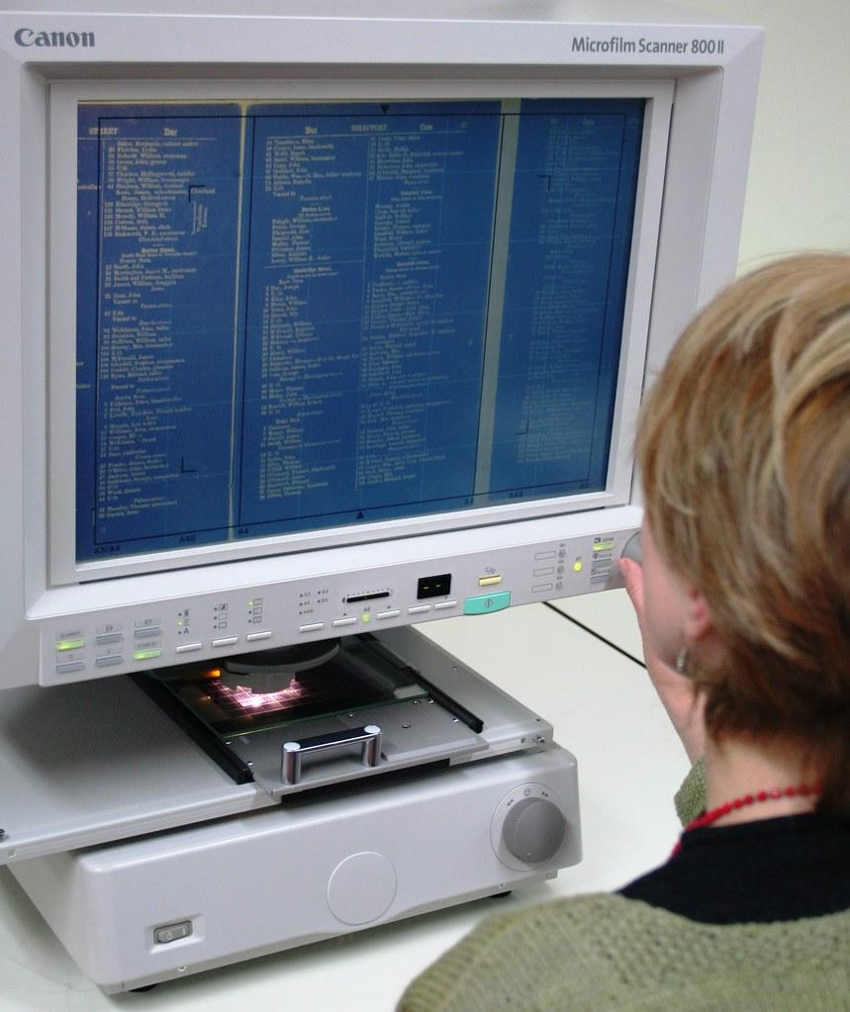
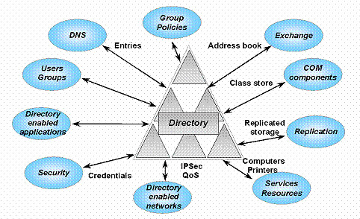
What does a directory service do?
Directory services can be primitive or complex
In principle, a directory server responds to queries from a user
The answer depends on the query
But also on the user and their attributes
Responses don’t change when query and attributes are unchanged and the directory has not changed
Different from web search, which sacrifices accuracy for scale and speed

Slide 3
In the exam
Request:
ID
A client asks for the directory information for an ID (ID>1000).
The server retrieves several values that are structured in a tree.
The values are simplified to some integers. In a real application these could be user permissions, files, …
Client
Server
Response:
8239
28623
23489
31185
2315
4128
9784
52137

Slide 4
In the exam
Request: 3454
A client asks for the directory information for an ID (ID>1000).
The server retrieves several values that are structured in a tree.
The values are simplified to some integers. In a real application these could be user permissions, files, …
Client
Server
ResponseSize: 8
Response
8239
28623
31185
2315
9784
LastResponse
23489
4128
52137

Slide 5
In the exam
8239
28623
23489
The client prints the received response in a tree pattern to the screen.
The output shows the tree structure in a simplified form.
Note: the client and server can store the tree internally however they want.
31185
2315
4128
9784
Client
52137
8239
--28623
----31185
----2315
------9784
--23489
----4128
------52137

Slide 6
In the exam
You implement functions in the client
The client is a white box, you have the source.
The client functions are in grey. They are yours, you have some precode.
The server is a black box, you find binaries on Github.
Client
Server
D1 module
D2 module
Tree module

Slide 7
3 steps to do this
Communication over UDP
called “D1”
with checksums and 1-bit acknowledgements
Request/Response protocol
called “D2”
on top of UDP
relies on correct packet delivery using D1
Build a client-side tree from the Responses
Parse the payload of the D2 packets
Recreate the tree on the client side (you don’t have to use pointers)
Print the tree on screen

Slide 8
Communication over UDP
The packet header for D1: sent over the network in network byte order
MSB
ACK packet if this is 1
ACK number
Checksum: 16 bits, network byte order
Size: 32 bits, network byte order
LSB
Sequence number, 0 or 1 if DATA packet
DATA packet if this is 1
12 unused bits, must be 0

Slide 9
Communication over UDP
The D1 packet: payload follows D1Header, protected by checksum
.
.
.
Payload, up to 1016 more bytes
struct D1Header
{
uint16_t flags;
uint16_t checksum;
uint32_t size;
};
typedef struct D1Header D1Header;

Slide 10
D2: Request/Response protocol
The D2 packet: in the payload of the D1 packets (as usual in layering)
type
struct PacketHeader
{
uint16_t type;
};
#define TYPE_REQUEST (1 << 0) /* type is PacketRequest */
#define TYPE_RESPONSE_SIZE (1 << 1) /* type is PacketResponseSize */
#define TYPE_RESPONSE (1 << 2) /* type is PacketResponse */
#define TYPE_LAST_RESPONSE (1 << 3) /* type is PacketResponse */

Slide 11
D2: Request/Response protocol
The D2 packet: in the payload of the D1 packets (as usual in layering)
TYPE_REQUEST
unused - set to 0 for checksumming
ID
struct PacketRequest
{
uint16_t type;
uint32_t id;
};

Slide 12
D2: Request/Response protocol
The D2 packet: in the payload of the D1 packets (as usual in layering)
TYPE_RESPONSE_SIZE
size
struct PacketResponseSize
{
uint16_t type;
uint16_t size;
};

Slide 13
D2: Request/Response protocol
The D2 packet: in the payload of the D1 packets (as usual in layering)
payload_siez
payload
.
.
.
struct PacketResponse
{
uint16_t type;
uint16_t payload_size;
};
TYPE_RESPONSE
OR
TYPE_LAST_RESPONSE

Slide 14
Tree nodes: the payload of D2
ID
value
Num_children (here 2)
ID of child[0]
ID of child[1]
id: 0-based index created by depth-first search on the server
struct NetNode
{
uint32_t id;
uint32_t value;
uint32_t num_children;
uint32_t child_id[5];
};
value: our MacGuffin
Up to 5 children
But unused children fields are not sent over the network.

Slide 15
The servers
Your client code must talk to our servers
Find binaries at https://github.uio.no/IN2140v2/in2140-v24-he
d1_dump <port>
Send one of your D1 packets to this server. The server checks whether your D1 header is as expected.
d1_server <port>
The d1_test_client with your implementation of d1_udp.c can connect to this server and send a few ping-pong messages.
d2_server <port>
The d2_test_client with your implementations of d1_udp.c and d2_lookup.c can connect to this server. The client sends a Request with an ID and the server answers with several Response packets with tree nodes.

Slide 16
The servers
Your client code must talk to our servers
Find binaries at https://github.uio.no/IN2140v2/in2140-v24-he
Currently available for
Linux Redhat 8.9 on Intel (static binary)
this works on IFI’s computers, login.ifi and in machines in Sed
Linux Ubuntu 22.04 on Intel (static binary)
this is popular for home use (and may work with WSL2)
MacOS 14.4 Sonoma on Intel (dynamic binary)
only Intel; no access to an ARM Mac

